Slide 1


CAPSTONE PROJECT
PROJECT TITLE
Presented By
Student Name: DEVESH SAXENA
College Name: POORNIMA Institute OF ENGINEERING AND TECHNOLOGY
Department: B.Tech - CSE (DS)
Email ID: deveshmns@gmail.com

Slide 2
OUTLINE:
Problem Statement (Should not include solution)
Proposed System/Solution
System Development Approach (Technology Used)
Algorithm & Deployment
Result (Output Image)
Conclusion
Future Scope
References

Slide 3
Problem Statement:
E-commerce businesses generate large amounts of sales data from different products, customers, locations, and payment methods. However, without an effective system to analyze and visualize this data, it becomes difficult for businesses to monitor performance, identify profitable products, understand customer purchasing patterns, and track monthly profit trends. Therefore, there is a need to develop an E-Commerce Sales Dashboard that can efficiently analyze and present key sales metrics such as total sales amount, profit, quantity sold, and average order value. The system should provide clear visual insights into sales by state, customer, product category, payment mode, and monthly profit trends, enabling businesses to make informed decisions and improve overall sales performance.

Slide 4
Proposed Solution:
To address the challenges of analyzing large volumes of e-commerce sales data, an interactive E-Commerce Sales Dashboard will be developed to collect, process, and visualize sales information in a clear and meaningful way. The system will integrate sales data from the e-commerce platform and organize it into structured datasets for analysis.
The dashboard will display key performance indicators such as total sales amount, total profit, quantity sold, and average sales value to provide a quick overview of business performance. It will include visualizations such as bar charts, pie charts, and line graphs to represent sales distribution by state, customer, product category, payment mode, and sub-category.
Additionally, the system will provide time-based analysis such as monthly and quarterly profit trends, allowing businesses to identify seasonal patterns and performance fluctuations. Interactive filters will enable users to select specific quarters or categories to analyze detailed insights.
By transforming raw sales data into interactive visual reports, the proposed solution will help business managers easily monitor sales performance, identify profitable areas, and make data-driven decisions to improve operational efficiency and profitability.

Slide 5
System Approach:
The system approach defines the strategy used to design and develop the E-Commerce Sales Dashboard for analyzing sales performance and business insights. The approach involves collecting e-commerce transaction data, processing and organizing the data, and creating interactive visualizations to help users understand key business metrics.

Slide 6
Algorithm & Deployment:
Algorithm
1. Algorithm Selection: This project uses a data analysis and visualization approach instead of a machine learning model. Tools like Power BI and DAX are used to analyze historical e-commerce sales data and generate business insights.
2. Data Input: The input data includes features such as Order ID, Customer Name, State, Product Category, Sub-Category, Payment Mode, Order Date, Sales Amount, Profit, and Quantity.
3. Data Processing: The dataset is imported into Excel/Power BI, where data cleaning and transformation are performed using Power Query. Calculations like total sales, profit, quantity, and average sales are created using DAX formulas.
4. Analysis Process: Visualizations such as bar charts, pie charts, and line charts are used to analyze sales by state, category, customer, payment mode, and monthly profit trends.
Deployment
The dashboard is developed using Power BI Desktop. After creating visualizations and KPIs, the report is published or shared so users can view it through Power BI Service, desktop application, or web browser. The system can be updated regularly by adding new sales data.

Slide 7
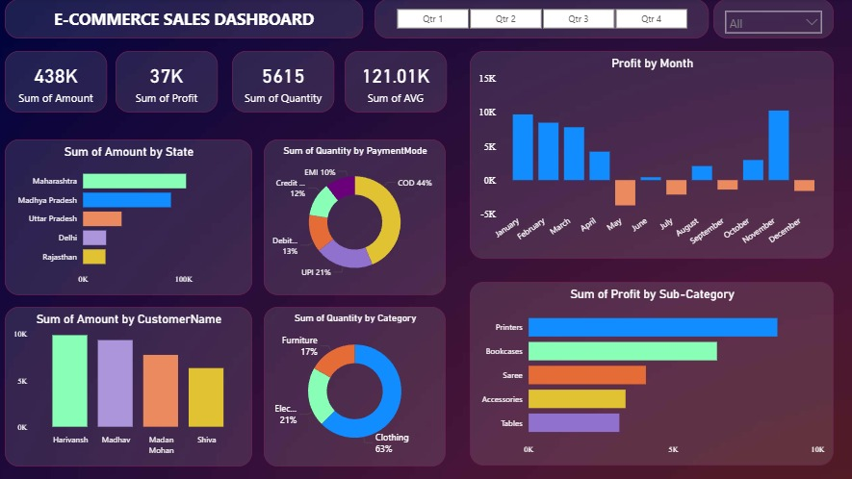
Result:
The developed E-Commerce Sales Dashboard successfully analyzes and visualizes the sales dataset to provide meaningful business insights. The dashboard displays key performance indicators such as total sales amount, total profit, total quantity sold, and average order value.
Through different visualizations, the system identifies sales distribution by state, customer, product category, and payment mode. The monthly profit trend chart helps in understanding seasonal variations in business performance, while the category and sub-category analysis highlights the most profitable products.
Interactive filters allow users to analyze data for different quarters and categories, making the dashboard flexible and easy to use. Overall, the system effectively converts raw sales data into clear visual insights, helping businesses monitor performance and make data-driven decisions.

Slide 8
Conclusion:
The E-Commerce Sales Dashboard project successfully analyzes and visualizes sales data to provide clear insights into business performance. The dashboard displays important metrics such as total sales, total profit, quantity sold, and average sales value, helping users quickly understand overall performance.
By using different visualizations like charts and graphs, the system allows analysis of sales by state, customer, category, sub-category, and payment mode. The monthly profit trend also helps in identifying seasonal patterns and profitable areas.
Overall, the project transforms raw sales data into interactive and meaningful visual reports, enabling businesses to monitor performance, identify trends, and support better decision-making for improving sales and profitability

Slide 9
Future scope:
The E-Commerce Sales Dashboard can be further improved by adding more advanced features and technologies. In the future, machine learning models can be integrated to predict future sales trends and customer purchasing behavior.
The dashboard can also be connected to real-time data sources so that sales information updates automatically. Additional features such as customer segmentation, inventory analysis, and product demand forecasting can help businesses improve marketing strategies and stock management.
Furthermore, the system can be deployed as a web or mobile application, allowing managers to access sales insights anytime and anywhere. These improvements will make the system more powerful and useful for strategic business decision-making.

Slide 10
References:
Kaggle. E-Commerce Sales Dataset. Available at: https://github.com/Devesh-Saxena/Power_Bi_Project
Provided the raw e-commerce sales dataset used for building the dashboard and analyzing sales trends.
GitHub Link: https://github.com/Devesh-Saxena/Power_Bi_Project

Slide 11
Thank You

